Slide 1

FreshCache:
Statically and Dynamically
Exploiting Dataless Ways
Arkaprava Basu, Derek R. Hower,
Mark D. Hill, Mike M. Swift

Slide 2
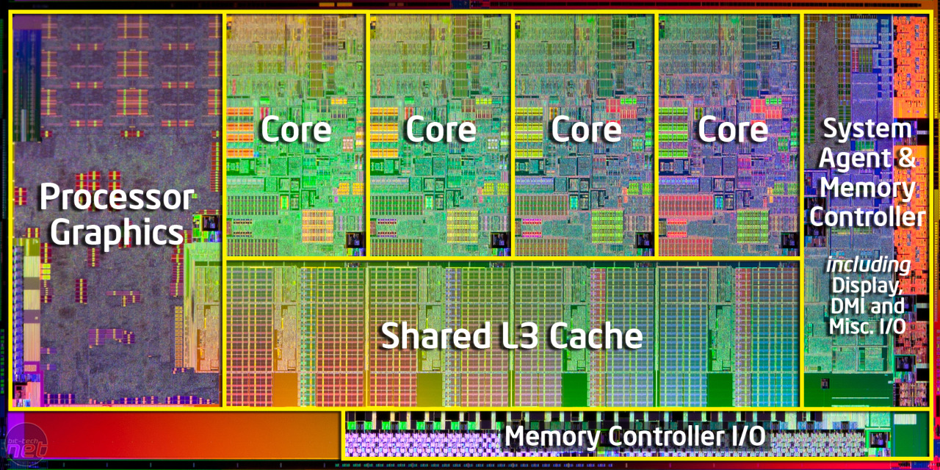
Last Level Caches: Area and Energy Hungry
Intel Ivy Bridge die picture
Notes:
Large portion of on-chip die area is often devoted to LLC sometimesup to 50%

Slide 3
Last Level Caches: Area and Energy Hungry
Intel Ivy Bridge die picture
LLC contributes up to 37% of on-chip power
[Sen et al., 2013, UW-TR 1791]
Notes:
Due to static power and since large number of transistors devoted to LLC they can contribute substantially to chip power.

Slide 4
Inefficiencies in LLC
Inclusive LLC wastes energy and area
  Transistors devoted to hold stale data
Notes:
However there are many inefficiencies in LLC, especially in commercially popular inclusive LLC where every block in the private caches of cores has a copy in the LLC.
For example in this case the block A is cached with exclusive permission at the C1’s private cache and a copy of which is present in the LLC. The C1 can update the content of the block without notifying the LLC.
Later if a core C2 requests the same cache line the tag and coherence meta data of the block present in the LLC is used to identify the owner of the block but the data portion of the block in the LLC is not usable. We cal this block with satle data. And transistors devoted to it is waste.
Talk about non modification case

Slide 5
Inefficiencies in LLC
Inclusive LLC wastes energy and area
  Transistors devoted to hold stale data
C1
C2
TAG
DATA
Private Caches
(L1/L2)
A :y
A :x
A :x
LLC + Directory
Block A is cached with exclusive permission in C1’s private cache
Notes:
However there are many inefficiencies in LLC, especially in commercially popular inclusive LLC where every block in the private caches of cores has a copy in the LLC.
For example in this case the block A is cached with exclusive permission at the C1’s private cache and a copy of which is present in the LLC. The C1 can update the content of the block without notifying the LLC.
Later if a core C2 requests the same cache line the tag and coherence meta data of the block present in the LLC is used to identify the owner of the block but the data portion of the block in the LLC is not usable. We cal this block with satle data. And transistors devoted to it is waste.
Talk about non modification case

Slide 6
Inefficiencies in LLC
Inclusive LLC wastes energy and area
  Transistors devoted to hold stale data
Amount of stale data varies across workloads
0.7
Fraction of stale data in
LLC blocks
Private Cache: LLC ratio ~ 1:4
Notes:
What is important is that the the amount of cache blocks with stale data varies across the workloads

Slide 7
Idea: FreshCache
Static:
  Omit data portion of a fixed number of ways
  Reduce area and energy overhead
Dynamic :
  Disable data ways at runtime
  Reduce more energy for when possible

Slide 8
Roadmap
Motivation and key idea
FreshCache: Static + Dynamic Dataless Ways
Design and Mechanisms
Evaluation
Summary

Slide 9
Static Dataless Ways (SDWs)
Set
TAG +
Metadata
Data
Way
Set-associative LLC

Slide 10
Static Dataless Ways (SDWs)
Number of dataless ways fixed at design time
✔
Saves both area and static power*
✗
Cannot adapt to workloads
Static Dataless Way
Set-associative LLC
* If blocks with stale data kept in SDWs

Slide 11
Dynamic Dataless Ways (DDWs)
Number of dataless ways adjusted at runtime
Workload A
Data ways Turned off
Dynamic Dataless Ways
Set-associative LLC

Slide 12
Dynamic Dataless Ways (DDWs)
Number of dataless ways adjusted at runtime
Workload B
Cache utilization is less for workload B
Set-associative LLC
Notes:
Workloads B is less cache sensitive than workload A.

Slide 13
Dynamic Dataless Ways (DDWs)
Number of dataless ways adjusted at runtime
Workload B
Data ways Turned off
✔
Opportunistically save more energy
✗
No area savings
Set-associative LLC

Slide 14
FreshCache Goals: Best of Both Worlds
Static: save area and energy
  Omitting transistors at design time
Dynamic: save more energy
  Turning off transistor when possible
How to tradeoff performance?
  Bounded by Maximum Performance Degradation
    e.g., MPD = 1% or 3%
  Minimize energy subject to MPD

Slide 15
FreshCache: Static + Dynamic Dataless Ways
Workload A/B
Dynamic Dataless Ways
Static Dataless Ways

Slide 16
FreshCache: Challenges
Put blocks with stale data in dataless ways
Determine number of DDWs at runtime
1
2

Slide 17
Roadmap
Motivation
FreshCache: Static + Dynamic Dataless Ways
Mechanisms
  LLC Controller → Manage Dataless ways
  DDW Controller → Determine number of DDWs
Evaluation
Summary
1
2

Slide 18
Dataless-Way-Aware LLC Controller
Keep blocks with stale data in dataless ways
1
Coherence state decides if cache block put in dataless way
SDW or DDW
Exclusive state
From Memory/Other Socket

Slide 19
Dataless-Way-Aware LLC Controller
Keep blocks with stale data in dataless ways
1
Coherence state decides if cache block put in dataless way
SDW or DDW
Shared state
From Memory/Other Socket

Slide 20
Dataless-Way-Aware LLC Controller
Keep blocks with stale data in dataless ways
1
Writeback to dataless way may move block to conventional way
Writeback from Private $
Intra-set block movement

Slide 21
DDW Controller
Determines number of DDWs at runtime
2
Energy savings
Maximum Performance Degradation (MPD)
Avg. Mem. Latency
DDW Cont.
Aggregator
Est. LLC miss
Hit Counters
Software specifies performance vs. energy savings tradeoff
MPD value specified in a register
Energy savings subjected to MPD
Aux. Tag Array
Qureshi’06
0.3% overhead
LLC miss Estimator

Slide 22
DDW Controller
Determines number of DDWs at runtime
2
Energy savings
Maximum Performance Degradation (MPD)
Avg. Mem. Latency
DDW Cont.
Aggregator
Est. LLC miss
Hit Counters
Aux. Tag Array
Qureshi’07
LLC miss Estimator

Slide 23
Roadmap
Motivation
FreshCache: Static + Dynamic Dataless Ways
Mechanisms
Evaluation
Summary

Slide 24
Methodology
gem5 full system simulation
8 in-order cores, 3-level cache hierarchy
Parsec and commercial workloads
CACTI 6.5 to evaluate area and energy savings
Evaluation:
  Efficacy of FreshCache in saving energy
  Area savings due to FreshCache

Slide 25
Energy Savings: MPD=1%
2 SDWs (out 16 ways) + variable number of DDWs
Relative Energy (LLC + DRAM access) Savings
28%
Percentage (%)
Avg. 28% energy savings with worst case perf. Degradation < 1%

Slide 26
Energy Savings: MPD= 3%
2 SDWs (out 16 ways) + variable number of DDWs
Relative Energy (LLC + DRAM access) Savings
MPD = 1%
28%
41%
Percentage (%)
Avg. 41% energy savings with worst case perf. Degradation < 3%

Slide 27
Area Savings
2 SDWs (out 16 ways) + variable number of DDWs
Relative Energy (LLC + DRAM access) Savings
MPD = 1%
28%
41%
8.23% of LLC area saved
Percentage (%)

Slide 28
Summary
LLC can be energy and area hungry
Inclusive LLCs holds substantial stale data
FreshCache:
  Static Dataless Ways to save area and power
  Dynamic Dataless Ways to save further power
28% Energy and 8.23% LLC area savings
  Worst case performance degradation <1%

