Slide 1
Calvin:
Deterministic or Not? Free Will to Choose
Derek R. Hower, Polina Dudnik,
Mark D. Hill, David A. Wood
Notes:
Middle initials.

Slide 2
Executive Summary
Determinism Valuable:
Same inputs Same multithreaded execution
Debugging, Fault Tolerance, Security
Performance Required:
Slow & deterministic not enough
Propose: Calvin
Leverages Total Store Order (TSO) in hardware to...
… deterministically order memory operations
Multiple modes w/o speculation
20% Deterministic (vs. software 1-11X)
8% Conventional
Determinism @ Good Performance
Notes:
On the right is the portrait of John Calvin. Controlling rather than reordering.

Slide 3
Outline
Motivation & Goals
Model
Implementation
Evaluation
Conclusion
Related Work (optional)
Notes:
Who this guy is? More familiar.

Slide 4
Want Deterministic Execution
Bug: unprotected account update
thread 0
if (account >= sum)
if (account >= sum)
account = 100
account -= sum;
account -= sum;
account = 0
account = 0
account = 0
Notes:
Operated correctly.

Slide 5
Want Deterministic Execution
Bug: unprotected account update
thread 0
if (account >= sum)
if (account >= sum)
account = 100
account -= sum;
account = 100
account -= sum;
account = 0
account = -100
Notes:
Operated incorrectly. Which will you get? Either one. 50% of the time is ok.

Slide 6
Specific Goals
Strong
Determinism
Performance
Strong Determinism:
Make no assumptions about program behavior
Help debug racey programs
Performance:
Small enough overhead to be on all the time
Compatibility:
Complex speculative cores
Non-speculative cores
Compatibility
Notes:
Circle in order cores.

Slide 7
Outline
Motivation & Goals
Model
Implementation
Evaluation
Conclusion
Related Work (optional)

Slide 8
Calvin: The Big Picture
Proc 1
Proc 0
Store A
Load A
Load A
Store B
Store B
Load C
Load D
Store D
Memory Order
Notes:
Add addresses. Do it fast. Brand new memory model.

Slide 9
Recall Total Store Order (TSO)…
TSO is a Relaxed memory model
Key point: write completion can be delayed
Memory Order
processor 0
local buffering
PC ->
ST A <- 1
ST A <- 1
ST A <- 1
ST A <- 1
R1 <- LD B
R1 <- LD B
R1 <- LD B
R1 <- LD B
R2 <- LD A
R2 <- LD A
Notes:
Dependent load-store pairs can still be reordered, but the loads get the most recent value. Consistent notation. Program counter. Move it over, on the side. Load move across, store move lower. Middle row.

Slide 10
Calvin Model: One Interleaving
Proc 0
Store A
Proc 1
Store A
Load A
Load A
Load A
Load A
Store B
Store B
Store B
Store B
Execute
all loads before all stores (execute)
all stores in processor order (publish)
Load C
Load C
Load D
Load D
Store D
Store D
Buffer
Buffer
Publish
Memory Order
Notes:
Addresses in. one bypass.

Slide 11
Calvin Model: Reduce Scope
Temporally divide multithreaded execution into global strata
Stratum S
Begin Stratum
PROCESSOR 0
PROCESSOR 1
Store
Load
Load
Store
Execute
Load
Load
Store
Load
Load
Store
Store
Publish
Store
Store
End Stratum and Synchronize
Stratum S + 1
Load
Begin Stratum
Load
Load
Store
Store
Execute
Load
Load
Time
Store
Store
Load
Store
Publish
End Stratum and Synchronize
Load
Load
Notes:
End stratum deterministically as well.

Slide 12
Stratum Termination Function (3 Modes)
Unbounded deterministic:
determinism → architectural events only, e.g. instructions
(#instructions == threshold) OR synchronization
Conventional:
performance → reduce load imbalance, e.g. cycle count
(#cycles == threshold) OR synchronization
Bounded deterministic:
determinism → architectural events only, e.g. instructions
(#instructions == threshold) OR (synchronization) OR
(resource exhaustion)
Notes:
Dash, one line equations

Slide 13
Outline
Motivation & Goals
Model
Implementation
Write Cache
MIST Protocol
Stratum Size Predictor
Evaluation
Conclusion
Related Work (optional)

Slide 14
Implementation: Overview
Implementation Challenges:
Stratification → Load imbalance due to barriers
Buffering → Conventional store buffers do not scale
Ordering → Serial flush is sloooooooow
Calvin-MIST Implementation:
Store buffers → Unordered write cache
Load imbalance → Stratum Size Predictor (in paper)
Fast flush → MIST Coherence Protocol
Notes:
Too long. This is forecast. Write cache. Other implementation innovations.

Slide 15
Unordered Write Cache
Proc 1
Behavior:
drops program store ordering
coalesces stores
prohibits loads in publish phase
Replacements/overflow:
Proc 0
Execute
Load A
Load A
Load C
Load B
Store B
Publish
Store D
Store A
End stratum
Bounded Deterministic Mode
Repeatable only on same HW
Log (TM-like)
Unbounded Deterministic Mode
Repeatable on any HW
Store D
Atomic Flush
Notes:
Inscrutable.

Slide 16
MIST Protocol
Goal: speed up publish phase
delayed “timebomb” invalidate (in paper)
write caches flush in parallel
Proc 0
Proc 1
Execute
Load A
Load A
Load C
Load B
Store B
Publish
Store D
Store A
Store D

Slide 17
Outline
Motivation & Goals
Model
Implementation
Evaluation
Conclusion
Related Work (optional)

Slide 18
Evaluation Methodology
Infrastructure
Bochs
GEMS
Workloads
Parsec
Mantevo
 | Base | Calvin-MIST
Cores | 8, 2.0 Ghz in-order pipelined
Write Cache | N/A | 64 entry, 8 way
L1 Cache | Private, Split L1 I&D, 32K 8-way, 1 cycle
Coherence Protocol | Conventional MOESI | Multiple Writer MIST
Barrier | N/A | 16 cycle latency
L2 Cache | Shared, 8MB, 16-way, 8 banks, 12 cycles
Directory | Distributed at the L2 banks
Notes:
Bochx x86.

Slide 19
Unbounded Deterministic Mode
Normalized Execution Time
publish
~20% slowdown
fine-grained locking
frequent overflow
Notes:
Separate parsec and mantevo. Load imbalance. What are the sources for the slowdown. Stalling in phase 2, logging. Strata size predictor needs discussion. Different shades of blue. Change the color of the mean bar to be different. Discuss slide. Describe the slowdown.

Slide 20
Bounded Deterministic Mode
Normalized Execution Time
publish
~20%
simpler HW
better stratum size
Notes:
Circle on mean.

Slide 21
Conventional Mode
Normalized Execution Time
publish
~8%
slowdown
bad stratum size
Notes:
What would be successful? Because unordered write buffer, stalling in phase2. Load imbalance. Wait for memory operations to complete.

Slide 22
Outline
Motivation & Goals
Model
Implementation
Evaluation
Conclusion
Related Work (optional)

Slide 23
Conclusion
Determinism Valuable:
Same inputs Same multithreaded execution
Debugging, Fault Tolerance, Security
Performance Required:
Uninteresting to be slow & deterministic
Propose: Calvin
Leverages TSO in hardware to...
… deterministically order memory operations
Multiple modes w/o speculation
20% Deterministic
8% Conventional
Determinism @ Good Performance

Slide 24
Outline
Motivation & Goals
Model
Implementation
Evaluation
Conclusion
Related Work (optional)

Slide 25
Related Work
DMP [Devietti, J. et al., ASPLOS ‘09]
First hardware solution for strong determinism
Good performance through TM-like speculation
Calvin seeks good performance with less speculation (power?)
Kendo [Olszewski, M. et. al., ASPLOS ‘09]
First software solution for weak determinism
Good performance, but not as general (e.g., debugging data races)
Calvin seeks good performance for strong determinism
CoreDet [Bergan, T. et al., ASPLOS ‘10]
First software solution for strong determinism
Exploits relaxed model, e.g., TSO with software store buffer
Performance left room for improvement
Calvin implements similar ideas in hardware to be fast
Notes:
Regret that short on timeb

Slide 26
Questions?

Slide 27
Backup Slides Follow

Slide 28
Calvin Model
Deterministically order memory operations within stratum
All loads before all stores
All stores are ordered by processor
Stratum S
processor 0
processor 1
Buffer
ST A <- 1
ST A <- 2
Buffer
A = 1
A = 2
R1 <- LD B
B = 3
R1 = 1
R0 = 2
R0 <- LD A
R2 <- LD A
R2 = 0
ST B <- 3
Memory Order
Execute
Publish
Notes:
Fix. Blue and red stacks. Blue on the left, red on the right. Split apart left and right. Get rid of R1 <- LD B. This is all you get, there is no normal stuff. Everyone is doing that.

Slide 29
Coherence Protocol
Write-back protocol
Allows parallel write cache flush
Allows fast reader invalidate
# states | MIST | MESI | MOESI
Stable @ L1 | 6 | 4 | 7
Transient @ L1 | 12 | 6 | 8
Stable @ L2 | 5 | 3 | 13
Transient @ L2 | 17 | 14 | 46
Total | 40 | 27 | 74
Notes:
Perform a load even though another processor is writing to that block. State what the invariants are. Dynamic self-invalidation. Multi-writer coherence protocol. Basically an MSI protocol with the addition. 46 is wrong.

Slide 30
L1 Cache States
State | Meaning | Global Invariant
I | Not Present/Invalid | 0 or more readers, 0 or more writers
S | Read Permission, no other writers in the system | 1 or more readers, 0 writers
M | Write permission, didn’t write in current stratum | 0 readers, 1 writer
Ts | Read permission until the end of the stratum | 1 or more readers, 1 or more writers
Mw | Write permission, wrote in current stratum | 0 readers, 1 writer
MMw | Write permission until the end of the stratum | 2 or more writers, 0 or more readers

Slide 31
Directory States
State | Meaning | Global Invariant | Valid Copy @
I | Not Present/Invalid | 0 readers, 0 writers | Memory
S | One or more readers | 1 or more readers, 0 writers | L2 Cache
M | Only one writer | 0 or more readers, 1 writer | Processor
MM | No readers/writers | 0 readers, 0 writers | L2 Cache
MS | Multiple writers | 0 or more readers, 1 or more writers | L2 Cache

Slide 32
Stratum Size Predictor
Stratum Size Predictor:
optimizes stratum size
adopts to loads imbalance
Large stratum:
reduce instruction mix variability
Small stratum:
adopt to synchronization
Proc 0
Proc 1

Slide 33
Reader Self-Invalidation
Processor 0
Processor 1
L1 Cache
L2 Cache
L1 Cache
LD
B: Shared
ST
Intent
B: Shared
B: Shared
Execute
B: Shared
B: Modified
B: Modified
B: Shared
B: Modified
B: Modified
Publish
Time
Notes:
Arrows

Slide 34
Predictor
Stratum Ends
MemBar?
C&BD: Overflow?
No
Yes
Decrement Predictor
Increment Predictor
Saturated?
Yes/Low
Yes/High
No
Size*2
Size/2
Stratum Ends

Slide 35
Predictor Helps Improve Performance
Speedup

Slide 36
Write Cache Size Affects Performance
Normalized Execution Time

Slide 37
Bottom Line
Normalized Execution Time
publish
Mantevo
Notes:
What would be successful? Because unordered write buffer, stalling in phase2. Load imbalance. Wait for memory operations to complete.

Slide 38
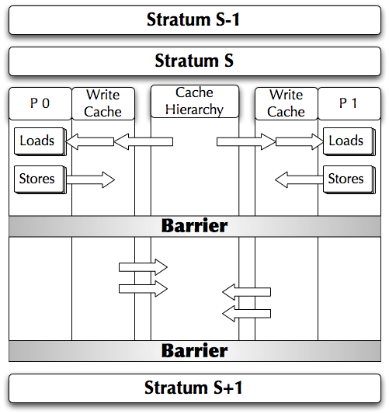
Calvin-MIST Operation
Notes:
Unhappy with coloring.

Slide 39
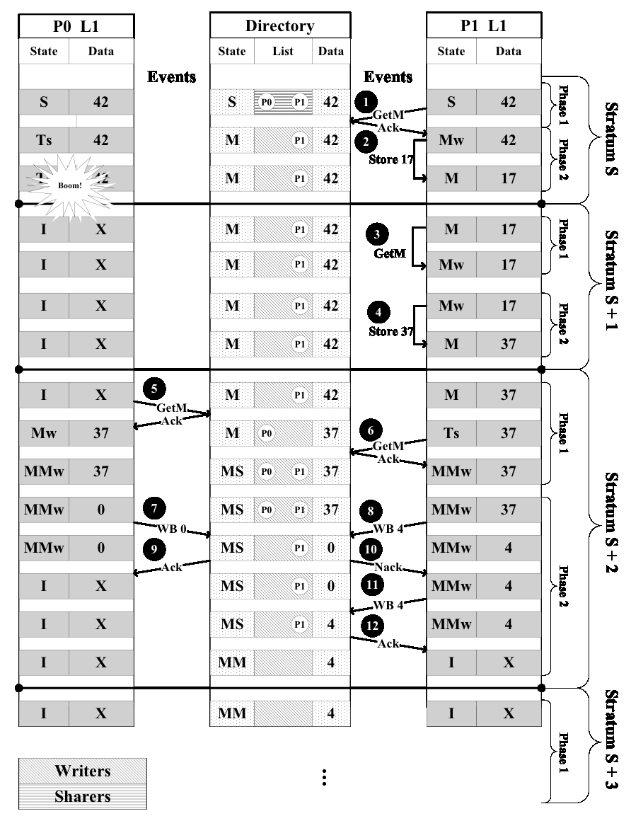
Example Protocol Operation

Slide 40
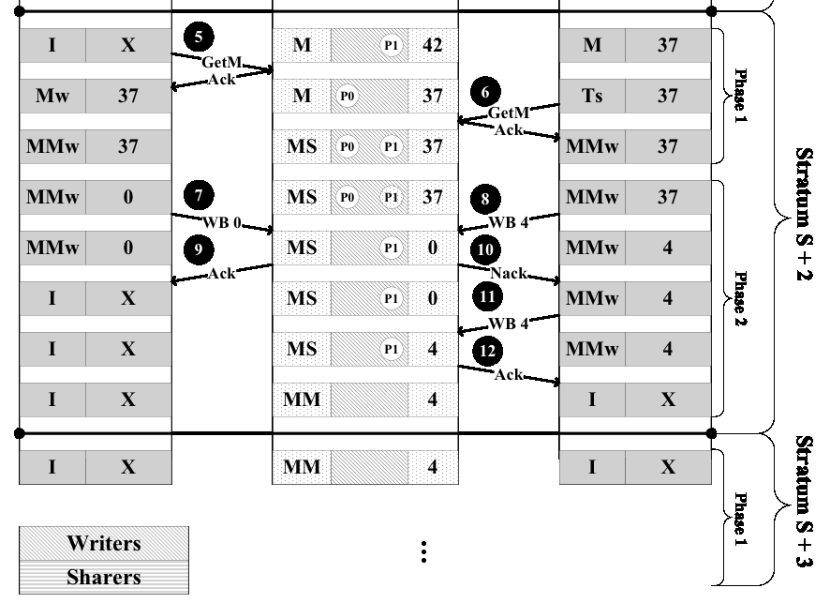

Slide 41
Atomic Operations
Ensure that only one atomic operation executes per stratum
Logically place the atomic operation at the end of the stratum
Terminate stratum on atomic operation
Execute both R and W parts of RMW as processor’s last store
Allows processors to communicate within a stratum

Slide 42
Multi-Writer Example
Execution Phase
Publish Phase
Core 1
Core 2
Write Cache
L2 Cache
Write Cache
NACK
ACK
ACK
FWD
FWD
L1 Cache
L1 Cache
Notes:
Perform a load even though another processor is writing to that block. State what the invariants are. Dynamic self-invalidation. Multi-writer coherence protocol. Basically an MSI protocol with the addition. 46 is wrong.

Slide 43
Atomic Operations
TSO atomic ordering rules:
All previous loads and stores
Atomic (both load and store portion)
All subsequent loads and stores
Calvin satisfies rules by:
Ending strata on atomics
Executing atomic op entirely in publish phase
Executing next instruction in next strata

Slide 44
Atomic Example
Proc 0
Proc 1
Load A
Load B
Store A
Load C
Memory Order
Stall
RMW L
Store B
Load A
Load A
Store C
Store C
Store L

Slide 45
Deterministic Input
Program’s repeatability depends on deterministic input
Input:
Use mechanisms from uniprocessor deterministic replay, e.g.:
Revirt
VMware Replay
FDR
Interrupts:
Delivered only on strata boundaries
Makes for easy logging (e.g., <vector #, strata #>)

Slide 46
Conventional Mode Slowdown
Sources:
Barrier latency (16 cycle)
Results indicate 4 cycle barrier largely eliminates overhead
Load imbalance
Especially in presence of fine-grained communication
Slow inter-thread communication
Threads cannot communicate within a stratum

Slide 47
With Average Stratum Size

